Slide 1
Compiler Construction
Lecture week 04-05

Slide 2
Outline
Parse Trees & Abstract Syntax Trees
Extended Notations: EBNF
Syntax Diagram
Top-down vs Bottom-up Parsing
Removal of Left Recursion
Left factoring

Slide 3
Parse Trees & Abstract Syntax Trees
Parse Trees
  A parsed tree corresponding to a derivation is a labeled tree in which
    the interior nodes are labeled by nonterminals
    the leaf nodes are labeled by terminals
    children of each internal node represents the replacement of the associated nonterminal in one step of the derivation
  The internal nodes can be numbered to show the order of derivation
  Parse trees can do left-most derivation as well as right-most derivation

Slide 4
Parse Trees & Abstract Syntax Trees (Continue…)
exp → exp op exp | ( exp ) | number
op → + | - | *
  Exercise: Construct a parse tree of expression
    30 + 45
    2 - ( 4 + 5 )
    2 + 4 + 6 * 20

Slide 5
Parse Trees & Abstract Syntax Trees (Continue…)
Abstract Syntax Trees
  A parse tree contains much more information than is absolutely necessary for a compiler
  The meanings or semantics of the expression should be directly related to its syntactic structure
  To imply this (e.g. 3+4) the root represents the operation by adding the values of two child exp sub-trees

Slide 6
Parse Trees & Abstract Syntax Trees (Continue…)
exp → exp op exp | ( exp ) | number
op → + | - | *
Exercise: Construct AST for the following expressions;
  3 + 4
  ( 15 + 10 ) * 4
  ( ( 20*15 ) + 4 )

Slide 7
Extended BNF (EBNF)
So far: Backus-Naur Form (BNF)
  Metasymbols are | → ε
Extended BNF (EBNF):
  New metasymbols […] and {…}
  ε largely eliminated by these
Parenthesis: Grouping:
  exp → exp (+ | -) term | term
  exp → exp + term | exp - term | term
The , operator: Concatenation
7

Slide 8
EBNF Metasymbols
Brackets […] mean “optional” (like ? in regular expressions):
  if-stmt → if ( exp ) stmt
  | if ( exp )stmt else stmt
  becomes:
  if-stmt → if ( exp ) stmt [ else stmt ]0
8

Slide 9
EBNF Metasymbols (Continue…)
Braces {…} mean “repetition” (like * in regular expressions
Replace only left-recursive repetition:
  exp → exp + term | term
  becomes:
  exp → term { + term }
9

Slide 10
Syntax Diagrams
Graphical representation for visually representing EBNF rules are called syntax diagrams
In syntax diagrams
  Nonterminal labels for each diagram represent the grammar rule defining that nonterminal
  Arrow lines represent sequence and choices
  A square or rectangle box is used to indicate non-terminals
  A round or oval box is used to indicate a terminal
10

Slide 11
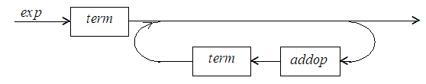
Syntax Diagrams (Continue…)
11

Slide 12
Syntax Diagrams (Continue…)
Exercise
  Draw a syntax diagram for variable declaration
    e.g. int x;
    e.g. int x,y;
    e.g. int x=10,y=20,z;

Slide 13
Parser
2 Basic types of Parsers:
Top down Parsing (start from start variable and ends on leaves)
  Recursive Descent
  LL(1) Parser
Bottom up Parsing (start from terminals and ends on start variable)
  Precedence Parsers
    Simple Precedence
    Operator Precedence
  LR Parsers
    SLR
    LALR

Slide 14
Types of Parser
TOP DOWN PARSER:
Start from start variable and ends on leaves
One operation à Generation/ Substitution
Left most derivation
BOTTOM UP PARSER:
Start from leaves and ends on Start variable
Reverse of Right most derivation
2 operations
  Shift (Reads input string)
  Reduce (String of symbols are replaced with non-terminal)
Stopping criteria
  We stop when we reach the start variable and complete input string is read

Slide 15
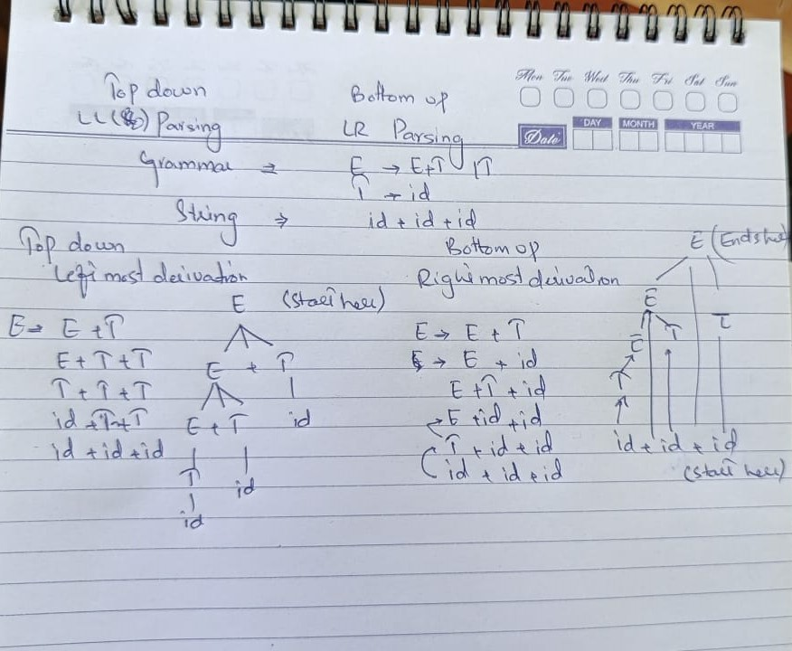
Difference between Top-down and Bottom-up Parsing

Slide 16
Top-Down Parsing
A top-down parsing algorithm parses an input string of tokens by tracing out the steps in left-most derivation
  Parse trees implies preorder tree traversals
Top-down parsers come in two forms; backtracking parsers and predictive parsers
  A predictive parser attempts to predict the next construction in the input string using one or more lookahead tokens
  A backtracking parser will try different possibilities for a parse of the input, backing up an arbitrary amount in the input if one possibility fails
16

Slide 17
Top-Down Parsing (Continue…)
Backtracking parsers are more powerful than predictive parsers
Backtracking parsers are much slower, requiring exponential time in general and, therefore, are unusable for practical compilers
Two popular top-down parsing algorithms
  Recursive-Descent Parsing
  LL(1) Parsing
17

Slide 18
Recursive Decent Parsing
The idea of Recursive Decent Algorithm is simple;
  We view the grammar rule for a nonterminal A as a definition for a procedure that will recognize an A
  The right hand side of the grammar rule for A specifies the structure of the code for this procedure
  The sequence of terminals on RHS correspond to matches of input
  The sequence of non terminals on RHS correspond to call to other procedures
  The choices on RHS correspond to alternatives (case or if-statements) within the code
18

Slide 19
Recursive Decent Example
Grammar rule:
factor → ( exp ) | number
Code:
    void factor(void) {
    if(token == number)
    match(number);
    else {
    match(‘(‘);
    exp();
    match(‘)’);
    }
    }
19

Slide 20
Recursive Decent Example (Discussion)
How lookahead is not a problem in this example?
  if the token is number, go one way, if the token is ‘(‘ go the other, and if the token is neither, declare error
  void match(Token expect) {
  if (token == expect)
  getToken();
  else
  error(token,expect);
  }
20

Slide 21
Error Handling in RD is Tricky!
If an error occurs, we must somehow gracefully exit possibly many recursive calls
Best solution: use exception handling to manage stack unwinding (which C doesn’t have!)
But there are worse problems: left recursion doesn’t work!
21

Slide 22
Left Recursion is Impossible
Grammar
exp → exp addop term | term
Code
void exp(void) {
if (token == ??) {
exp(); // uh, oh!!
addop();
term();
} else
term();
}
22

Slide 23
Repetition & Choice: Using EBNF
Consider the following grammar and try to write its pseudo code for recursive descent;
if-stmt → if ( exp ) statement |
if ( exp ) statement else statement
Consider the following grammar and try to convert it in recursive descent compatible grammar:
exp → exp addop term | term
23

Slide 24
Removing Left Recursion
LL(1) suffers the same problem due to left recursion as RD does
EBNF is not a solution for LL(1) hence we need to rewrite grammar and remove left recursion from it
Consider the following case
  A → Aα | β
  Here α and β are combination of terminals and nonterminals where β does not begin with A
  This type of grammar will generate string of type β[αα….]
  The resultant will be: A → βA’
  A’ → αA’ | ε
24

Slide 25
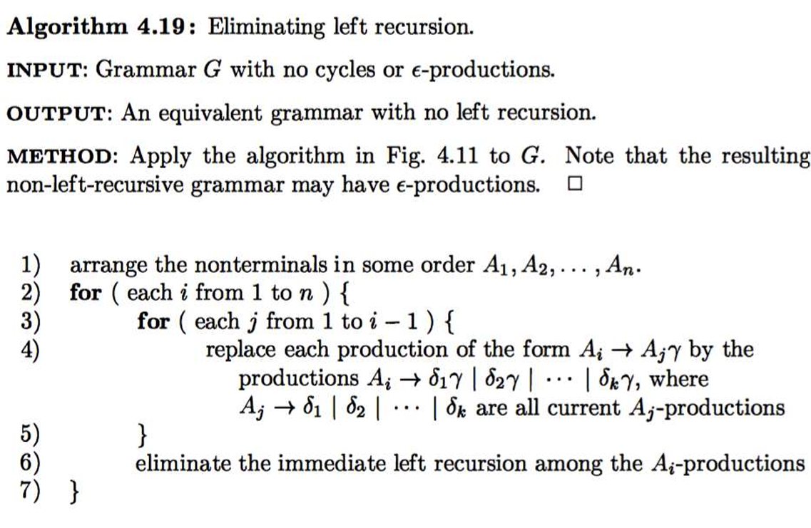
Elimination of Left Recursion Algorithm

Slide 26
Examples:
X à X ab | Ya | bH
X à X bc | X ab | bcX |ab Y
Y à Z a | bb
Z à Y b | aa
A à Ba | bB
B à C bb | ε
C à ab | Abb

Slide 27
Left Factoring
Left factoring is required when two or more grammar rule choices share a common prefix string, as in the rule
A → αβ | αγ
Obviously an LL(1) parser cannot distinguish between the production choices in such a situation
The solution in this case is to ‘factor’ the α out in the left and rewrite the rule as two rules;
A → αA’
A’ → β | γ
27

Slide 28
Examples:
Sà acd | abc | acf
S à aX | bY
X à ab | bcd
Y à X | bcf

Slide 29
Problems to address in Top-down Parsing
LEFT- FACTORING TECHNIQUE:
  LL(K) GrammaràLL(1) grammar
  Parser will perform efficiently if grammar is LL(1)
  Every LL(K) grammar cannot be converted into LL(1)
Ambiguous grammar:
  More than 1 parse tree for a single
  Parser will not be able to decide which parse tree should be constructed
  Its not necessarily possible to convert ambiguous grammar into un ambiguous
Left- Recursive grammar:
  Top down parser cannot be constructed for a left recursive grammar
  Left-recursive grammar is not LL(k)
  Always possible to remove left-recursion

Slide 30
Error Recovery in Top-Down Parsers
A parser should try to determine that an error has occurred as soon as possible. Waiting too long before declaring error means the location of the actual error may have been lost
After an error has occurred, the parser must pick a likely place to resume the parse. A parser should always try to parse as much of the code as possible, in order to find as many real errors as possible during a single translation
30

Slide 31
Error Recovery in Top-Down Parsers (Continue…)
A parser should try to avoid the error cascade problem, in which one error generates a lengthy sequence of spurious error messages
A parser must avoid infinite loops on errors, in which an unending cascade of error messages is generated without consuming any input
31

Slide 32
Summary
Any Questions?

